Slide 1


Network Intrusion Detection Using Artificial Neural Networks
This project focuses on developing a network intrusion detection system using artificial neural networks. The system is trained on the KDD Cup 1999 dataset, a subset of the original data, with the goal of improving accuracy and time-efficiency compared to traditional rule-based methods.
ARNAB DAS ID:19301029
AVIZIT SARKAR ID:19201113

Slide 2
Table of Contents
Dataset Overview
Exploratory Data Analysis
Methodology
Data Preprocessing
Neural Network Architecture
Experimental Results
Hyperparameter Tuning and Optimization
Future Work
Conclusion
Acknowledgements
Resources Used
References

Slide 3
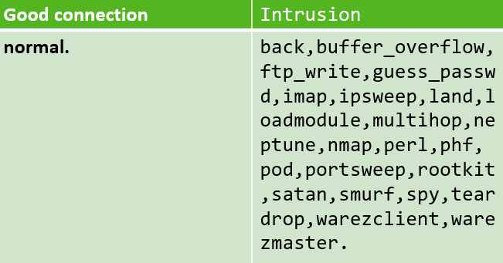
Dataset Overview
Normal Connections
1
The dataset includes typical network traffic that is considered "normal" or non-malicious.
2
Intrusion Types
The dataset also covers a variety of network attack types, such as buffer overflow, FTP write, password guessing, and denial-of-service attacks.

Slide 4

Exploratory Data Analysis
1
494,021 Rows
2
42 Columns
3
23 Output Classes
The KDD Cup 1999 dataset contains 494,021 rows of network connection data.
Out of the 42 columns, 41 represent various features of network connections, and the last column indicates whether the connection is normal or an intrusion.
There are 23 output possibilities, with one representing a normal connection and the remaining 22 representing different types of intrusions.

Slide 5
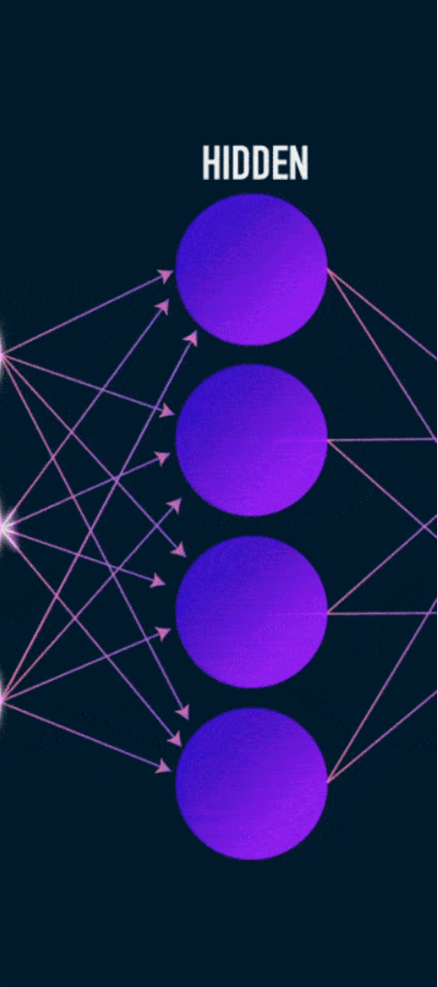
Methodology
1
Data Preprocessing
Encoding non-numerical features, applying PCA for dimensionality reduction, and normalizing input features.
2
Neural Network Architecture
Five-layer architecture with one input, one output, and three hidden layers using ReLU and Sigmoid activations.
3
Hyperparameter Tuning
Experimenting with training/test split ratios, batch sizes, PCA components, and early stopping to optimize performance.

Slide 6

Data Preprocessing
Feature Encoding
Dimensionality Reduction
Normalization
Non-numerical feature values and output possibilities were encoded with numerical values.
Principal Component Analysis (PCA) was applied to reduce the dimensionality of the data while preserving most of the relevant information.
MinMax scaling was used to normalize the input features, further improving the model's accuracy.

Slide 7
Neural Network Architecture
Input Layer
Hidden Layers
Output Layer
The input layer receives the preprocessed network connection data.
The output layer uses Sigmoid activation to predict whether the connection is normal or an intrusion.
Three hidden layers with ReLU activation function to capture complex patterns in the data.

Slide 8
Experimental result (Part-1)
Split ratio (training/test)
Test Accuracy
0.75 / 0.25
0.9922
0.65 / 0.35
0.9937
0.55 / 0.45
0.9932
0.45 / 0.55
0.9917
0.35 / 0.65
0.9909
0.25 / 0.75
0.9903
0.15 / 0.85
0.9887

Slide 9
Experimental result (Part-2)
Number of Components
Highest Accuracy
3
0.9937
6
0.9938
10
0.9938
12
0.9941
16
0.9945
32 (Optimal)
0.9991 (Optimal)
38
0.9990

Slide 10
Hyperparameter Tuning and Optimization
1
Training/Test Split
The 0.65/0.35 split ratio yielded the highest test accuracy of 0.9937.
2
Batch Size
A batch size of 128 provided the best balance between training time and accuracy.
3
PCA Components
32 PCA components achieved the optimal test accuracy of 0.9991.

Slide 11
Future Work
Explore Alternative Encoding Methods
1
Experiment with different encoding techniques for the input features to further improve the model's accuracy and efficiency.
2
Optimize Feature Selection
Investigate the impact of removing continuous feature columns to streamline the neural network architecture and reduce training time.
Enhance Preprocessing Techniques
3
Evaluate the use of advanced data preprocessing methods, such as advanced scaling or dimensionality reduction, to enhance the model's performance.

Slide 12
Conclusion
Successful Implementation
Continuous Improvement
Practical Application
This project showcases the potential of artificial neural networks in addressing real-world cybersecurity challenges, paving the way for more advanced intrusion detection systems in the future.
The neural network model developed for network intrusion detection has demonstrated high accuracy and efficiency, achieving an optimal test accuracy of over 99%.
While the current solution is satisfactory, the team has identified opportunities for further optimization, such as exploring alternative encoding methods and evaluating the impact of removing certain feature columns.

Slide 13

Acknowledgements
Academic Advisors
Peer Reviewers
Online Resources
We would like to express our sincere gratitude to our academic advisors for their invaluable guidance and support throughout this project.
We appreciate the insightful feedback and constructive criticism from our fellow students, which helped us refine and improve our work.
We are thankful for the wealth of knowledge and examples available online, which were instrumental in shaping our understanding and implementation of the network intrusion detection system.

Slide 14
Resources used
Primary Sources
Online Resources
Inspiration
The project relies on several primary sources, including the KDD Cup 1999 dataset and technical papers from leading experts in the field of network intrusion detection.
The team drew inspiration from cutting-edge research papers on network intrusion detection using deep learning, as well as open-source project examples that demonstrated effective implementation strategies.
The team also consulted various online tutorials, blog posts, and video lectures to deepen their understanding of neural network architectures and optimization techniques.

Slide 15
References
KDD Cup 1999 Dataset
http://kdd.ics.uci.edu/databases/kddcup99/kddcup.data_10_percent.gz, date and time of access: 19.04.2024 | 14:31
2. KDD Cup 1999 Task Description
http://kdd.ics.uci.edu/databases/kddcup99/task.html, date and time of access: 19.04.2021 | 15:01
3.Neural Network Fundamentals Video
https://www.youtube.com/watch?v=VgyKQ5MTDFc, date and time of access: 20.04.2024 | 15:22
4.T81-558: Applications of Deep Neural Networks
https://sites.wustl.edu/jeffheaton/t81-558/, date and time of access: 20.04.2024 | 16:36
5.MinMax Normalization in Python
https://towardsdatascience.com/everything-you-need-to-know-about-min-max-normalization-in-python-b79592732b79, date and time of access: 20.04.2024 | 16:39
6.Scikit-learn PCA Documentation
https://scikit-learn.org/stable/modules/generated/sklearn.decomposition.PCA.html, date and time of access: 22.04.2024 | 21:50
7.Keras Sequential Model Guide
https://keras.io/guides/sequential_model/, date and time of access: 22.04.2024 | 21:51
8.Keras Layer Initializers
https://keras.io/api/layers/initializers/, date and time of access: 22.04.2024 | 21:55
9.Keras Activation Functions
https://keras.io/api/layers/activations/, date and time of access: 22.04.2024 | 21:57
10.Keras Categorical Cross-Entropy Loss
https://keras.io/api/losses/probabilistic_losses/#categorical_crossentropy-function, date and time of access: 22.04.2024 | 22:31
11.Keras Optimizers
https://keras.io/api/optimizers/, date and time of access: 22.04.2024 | 22:37

